Slide 1
RetailGraph 2.3.0.0
Version Date :22/09/2012

Slide 2
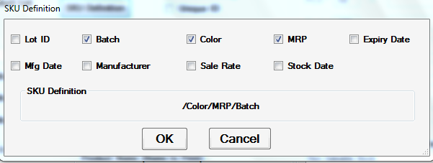
New Options
SKU Definition::Barcode generation on the basis of Stock Keeping Unit Definition defined in System default, Product Category, Product
Priority order will be Product Master/Product Category/System Default
In Stock: New barcode will be generated for new lot only when SKU def. doesn’t match for an any of the existing lot
Out Stock: Assign lot matching with Barcode and Selling Rate. ; not on the basis of batch/color/mrp; will ask for issue available if no such lot is found (from there, if selected next lot with stock will be assigned )
Default Definition: BATCH/COLOR/MRP
Definition units are:

Slide 3
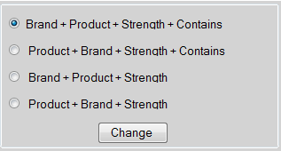
Sales Order::Assignment of document type in Sales order
Provided option of document type for sales order: Performa Invoice/Standing Order/Quotation in transaction series master .For each document type there will be an option on the sales menu
While making series , you will select sales order as transaction and then suitable document type.
Rest working is same as in version 1.1
System Maintenance::Option in system maintenance to Include/Exclude Unit in Name To Display

Slide 4
Payroll::Employee selection also available on alias/code in payroll
Export/Import Data:: Now Import Barcode option in Import Sales Invoice works to Import same Lot No as Exported from Purchase Invoice.
Auto Seed Series Id’s According to branch :Now when you change Branch in System Default, it will change Series ID in Data if Transactions not Exist.
Recipe Master:: Option in inventory master menu to define a recipe for product conversion
User can define input and output products which will work as a prototype,
Define quantities of the product according to the ratio of consumption and production
Subsequent use in Product Conversion
Select recipe to auto fill your product conversion entry and then change the output product entry as per requirement and click on recalculate to see changes in the input product quantity .
Transactions::Option to set print count for all the transactions user wise, from user master
Set number of prints for a particular user from user master. this will set the exact number of prints that are allowed for the user. It will work when the print(locked) section is unchecked for the role of the user, otherwise user can print the transaction infinite number of times

Slide 5
Transactions:: Option in transaction series master to lock the manual generation of entry number for a transaction. If checked then a new entry will always be generated according to the previous entry. Here if the user enters a non existent entry number then a message will be displayed and the entered entry number will be changed to 0.
Transactions::Case Lot Column in Transactions.
Transactions::Option to export header details of transactions from the export to excel option of the ribbon and the shortcut key ‘Ctrl+0’ . To export data only for the detail grid , you can use the option of available on the context menu strip available on right click
Order Book::Option to print data according to the entry date in order book
Product Master:: Option to feed default best before for a product .
Will calculate expiry according to the mfg date in all the in stock transactions
Option to edit the same in transactions , which will recalculate expiry according to the given duration
Reverse calculation will also be applicable in case direct expiry date is entered and not the “best before” duration

Slide 6
Currency:::Working of currency display will be now according to the currency provided in the system default home currency option,
Default for existing clients it has been provided as rupees
Vat Form::New VAT Forms VAT Form 11(2012)and VAT Form 11 9CSTB for Rajasthan
E-return for VAT Form 10(2012) available in CSV format in export e-return files

Slide 7
Version 2.3.1.0
Masters
Transaction series::Date Carry Forward Option
When Checked existing working will continue i.e. date of transaction will remain same even after the system date is changed unless the form is closed.
When unchecked , transaction date will be changed to system date when new is clicked
Delete Master Data
Will show transaction along with the transaction number in which references of to be deleted data is present

Slide 8
System Default
Auto Add Refer By while making sales invoice
Provided Check box in system default->Retailg Settings to auto add refer by from sales invoice
Show Last Sales/Purchase Detail on Product Selection in Transactions.
Check boxes to enable or disable last sale and purchase details from footer area of transactions
Common
Message when enter already existing entry number or reference number and data exist in product detail grid.
Remarks of Billing Head in Narration of Vouchers
When posting of billing head is in a separate account than that of customer
Removed validations for mandatory expiry date and number for Credit Card from payment mode.
Default cursor on Amount column of payment mode according to the selected payment mode.
Restore Data without Password
Now password is not required for restoring database backups
Change Series & Location Data According To branch
When a new branch is created, in a fresh database then the series and stock location will be seeded according to the id of the branch
Message on Save of Purchase Invoice when Selling Rate is Zero.

Slide 9
Total of QtyInNos column in Grid Footer
Editable Entry number for drafted entries
You can set entry numbers for your drafted entries by typing the required entry number in the entry no. control
Now cursor in header part of transactions will set on first control with allow focus.
Alias with Account Name in List of Accounts.
Issue Location Transfer
Date Range in Collect Expired Data.
When clicked on collect expired data, then expiry detail report will open.
Update the product list of transaction by selecting desired products and clicking on update button
Product Conversion :
Print Barcode option in Header will always work for Output Products
Now it will not open Batch list for Output products, when auto open batch list is selected for Input Products.
Solved Problem MRP not change when first select 'A' product and than change it to 'B'.

Slide 10
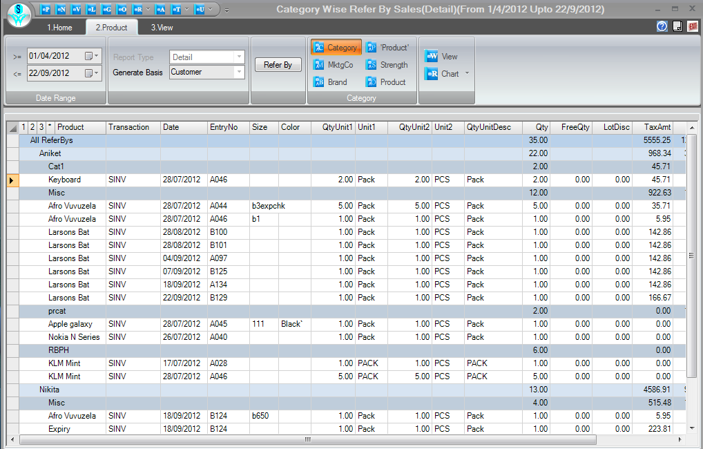
Reports
New Tab Product wise Sales with Product Grouping Options in Refer by wise Sales Report.

Slide 11
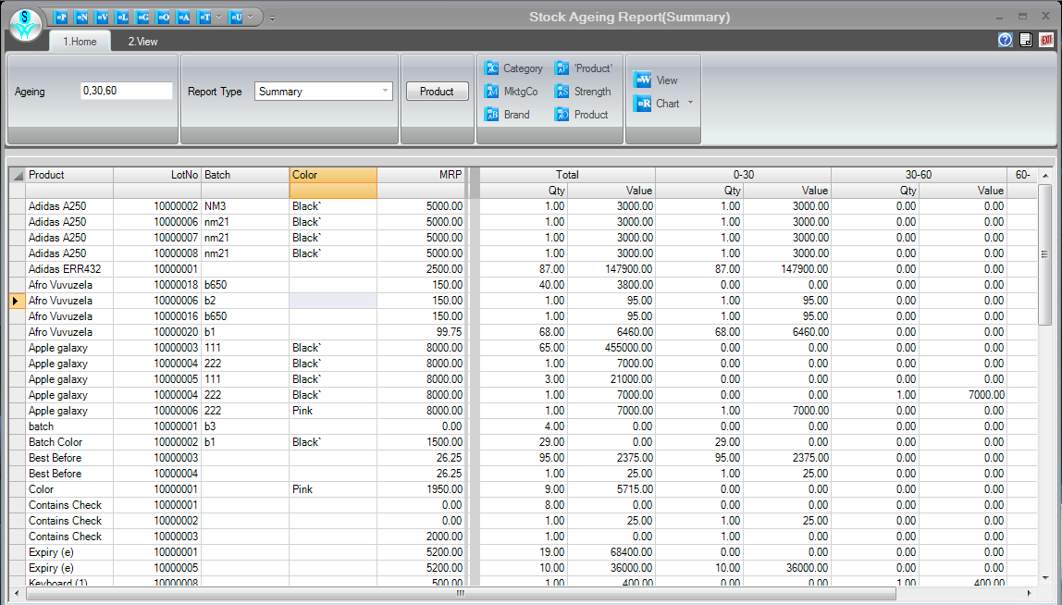
Stock Value Column in Stock Ageing Report
Stock value according to the age of stock selected is available at the valuation rate

Slide 12
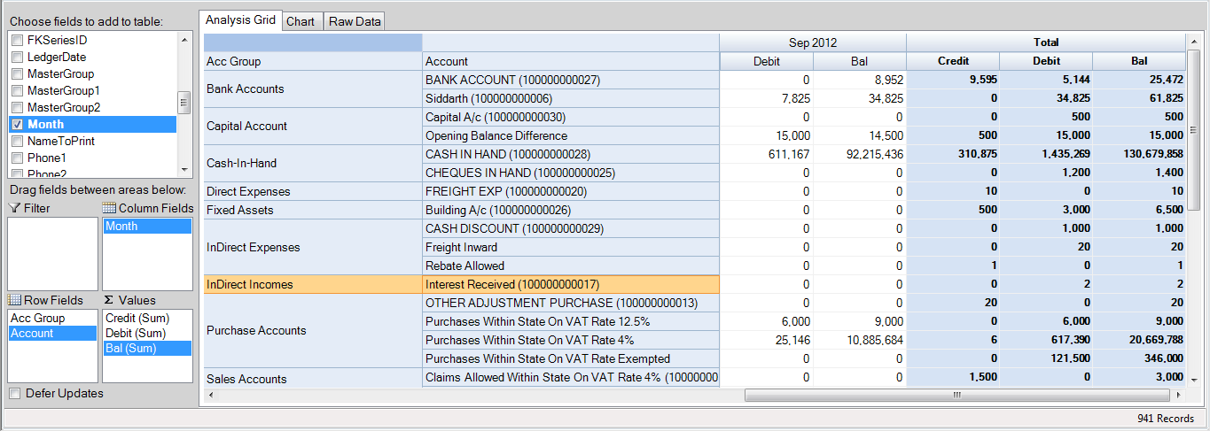
Ledger Display in Analysis

Slide 13
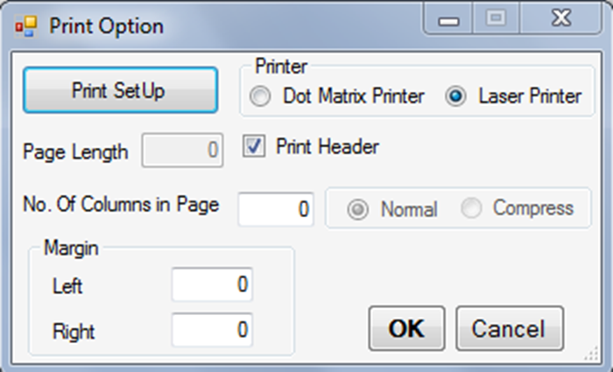
Date Range in A/c Group Detail report
Option to set Left/Right Margin & No.Of Columns in Print Option Window.

Slide 14
Changes in Not Ordered tab of Reorder Report
Action(Red): Dump Items (Stock Date is older than current date + Dump days. Max level> 0, Stock > max level)
Action(Green): Not Sold in period given for minimum level but sold in period given for max level(min level=0, max level >0 Stock > 0)
Ok: Products having min level>0, max level >0 , Stock >= Min level (Sufficient Stock is available)
Check(Yellow): Max level >0 , Stock> Max Level, Stock Date >Dump days
Check(Pink): Max =0, Stock=0
Check (Red):: Dump Items (Stock Date < Current Date +Dump days, max level =0, Stock>0)
Check (Green) : Max level=0, Stock >0, Stock Date >Dump Days

Slide 15
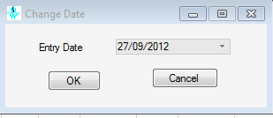
Product Conversion option is now available in Check List Report
Different colors for Input/Output Products of Product Conversion in Transaction Query
Remarks columns available in transaction status reports, sales transactions, sales detail report, purchase detail report , purchase transactions, invoice wise profit and ledger display
Option :
Change Date option to set Default Entry Date on Transactions.
Change default date of all the transactions from this option
Now caption in Messages also Update when captions like Batch/Color etc. are changed
When change is made in the english name in caption tab of system default then, all the corresponding messages coming from database will be updated accordingly

Slide 16
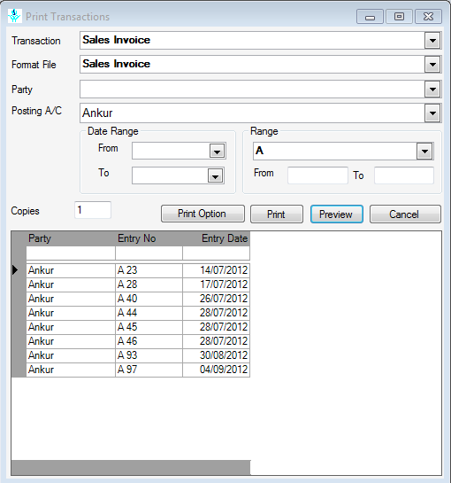
Account Selection in Print transactions to Print Transactions for selected Posting Account.
To print data according to the posting account in receipt/payments/sales and purchase transactions

Slide 17
Removed option of setting MRP from System default
It will always work from product category
Removed System Default 'Auto Issue Available Stock‘
Now it will always ask for the issuing stock from another lot with matching SKU
Removed Option of Issue Available stock from all other Lots.
Working of Issue Available is changed, now it will issue stock for matching SKU only.
Removed Series No column from Series Link table.
Now new series will always be generated with id max +1
Removed Lot Link Table
Now new lot will always be generated with id max +1
Removed Option 'Generate New Lot' from Export/Import Transactions
Now it will always generate new lot while import.
Removed Option 'Update Rates at Branch' from System Maintenance.

Slide 18
Resolved Issues
Customer/vendor master entry not saving when station exist in address section
Invoice Format not showing Station of Company when not use sub-report for Company Information.
Grid lines not coming in trial balance and ledger display.
Expiry Date Consider when assign Stock even Expiry is not Applied on Product.
Purchase showing Expiry Date of Last Lot when Product List is Optimized on Alias.
Sales Credit Note not showing Invoice List when Type Name of Walk in Customer (582030).
When Clear Purchase Challan in Purchase Invoice & Sales Rate Calculation is based on Product Master (User Defined),then assign Sales Rate from Product Master in place of Purchase Challan.
Apply Promotion when two promotions applied like one product is free with another product and same product have free qty promotion (581745)
Check List showing Error on SQL Server 2005.
Print Barcode option not working in Output Grid of Product Conversion.
UniqueID Stock disturbed in case of change Actual stock from Shortage to Surplus or vice versa.
When auto clear Pending Orders on product selection, it assigns Rate from Order.

Slide 19
Solved Problems
User Name not Print in Add mode of Transactions.
Selection from list in Export/Import Transaction when Tag Master Data
Round Of Factor not working Proper in Salary Head.
Virtual Items not working proper in Restaurant UI When Actual Items defined for Virtual Item
Delete Unused Lot option showing Run Time Error
Apply Promotion when two Promotion Product Selected in Transaction and
Qualifying Qty is different for both products.
Reconcile Current Stock showing Run Time Error when Select Lot from Batch/Color/MRP column.
Import Purchase Invoice Overwrite Existing Lot Details on the Basis of LotID.
Now when SKU is different new Lot will be generated.
Import Transaction with Import Barcode Option not check for Duplicate Barcode

Slide 20
VAT Form 48 of Road permit no. not showing and Vat computation report date range not coming while print
Name To Print not changed when make any changes in Product.(582380)
Sales Invoice save without Batch/Color in Return grid when display messages for stock.
When Print Product/Customer/Vendor/Account Master Prints only 45 Records.(582373)
Export Transaction is showing message of Access Denied when click on EMail Option.(582369)
Opening Form when Multiple forms of same transaction are Open(581731)
Non Moving Items report showing Items Received in current Purchase.(582363
Problem of ';' syntax when transaction is scheduled from scheduler
Manufacturer is changed when Import Purchase invoice at Branch.
Column name not coming proper in case of printing with Dot matrix Printer

Slide 21
Import Product Master from Excel sheet not working to Insert New Products in Existing Data.
Calculate MRP System Default is working for all categories(Removed from system Default)
Working of Issue Available is changed, now it will issue stock for matching SKU only.
In Purchase Invoice Batch/MRP pick from List if matching values exist in List.(e.g feed A512 And A5123 already exist in list then it will assign A5123 from List)
Refer By master :when trying to save a refer by assigning values in the commission detail of product category
Series according to payment mode of walk in customer
Issue in Connection string in Extra Fields of Barcode Format

