Slide 1
RetailGraph 2.3.2.0
Version Date :15/10/2012

Slide 2
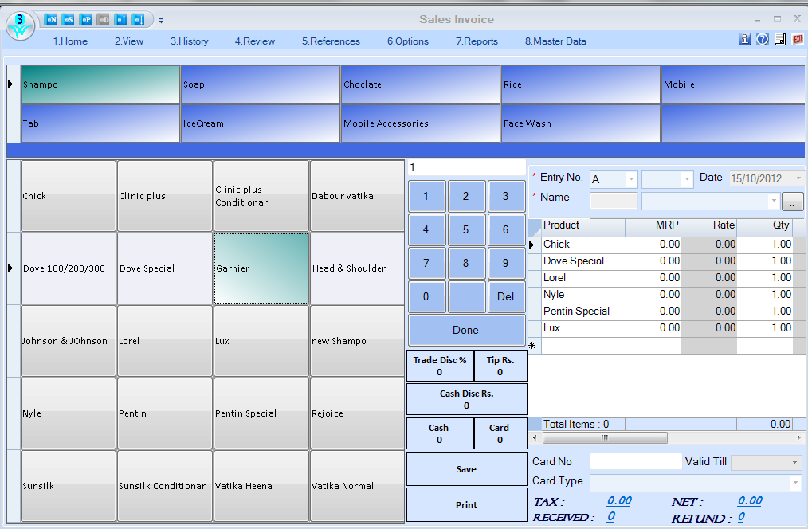
Version Note
New touchscreen optimized optional UI for Sales invoice, Sales order and Sales Challan (Available in patch 2.3.2.1)

Slide 3
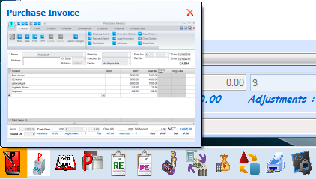
Now Entry Date of Transactions will show Last Date of Financial Year if Current Date is greater than Last Date of Financial Year.
Allow zero rate option in transaction series for Sales Invoice and Sales Challan to save bills with products having zero rate.
Option to close form from the thumbnail in the task bar of Retailgraph
Cancel option is available on Accounting Vouchers.

Slide 4
System default
Option to consider 1st, 15th or last day of the month as expiry date in case expiry date format is set as MM/YY and best before is not defined
Now like transactions, log of masters is also maintained in database
Search Option in Account Group Master
Provided option for cut command ,margins and no. of columns in system default for printing of reports
Reports
% VAT type column in Haryana-Vat Form C4
New VAT Form 36 for Rajasthan
Changes in Dynamic forms to Generate form defined on web Database.
Now Auto Adjustment Option in Receivables/Payables Reports will check for customer/Vendor also to adjust On A/c Amount.
Option to assign LR no and Carrier services to multiple bills from Invoice Summary

Slide 5
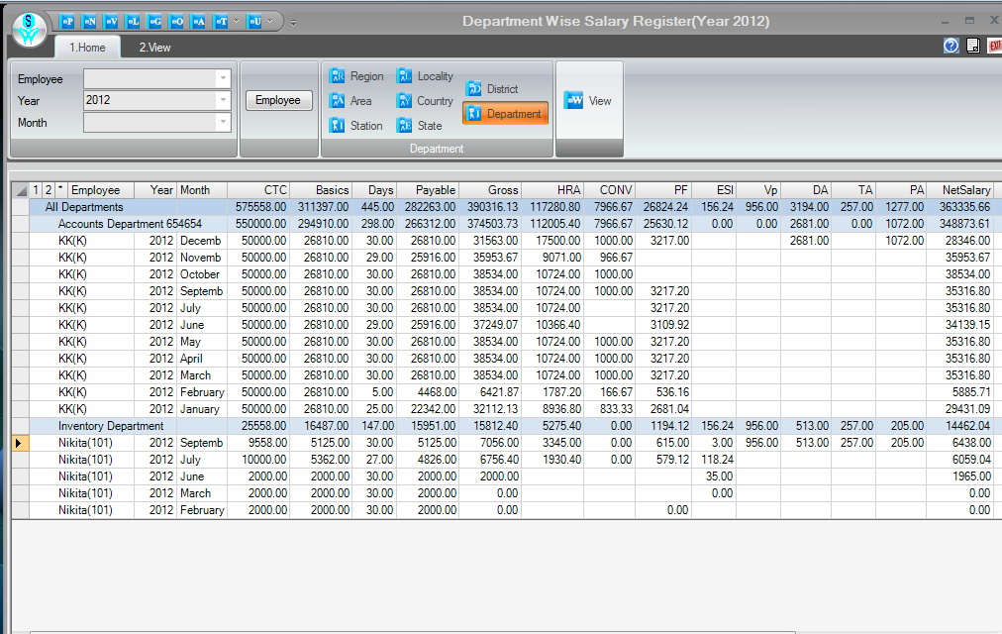
Employee filter and department grouping option in payroll reports

Slide 6
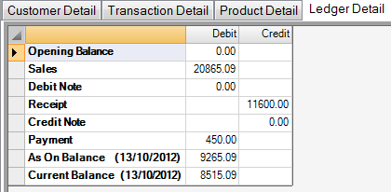
Payment Detail of Customer in Customer Query in Ledger Detail Tab.
Removed Virtual Item Option in Customer Query, Now Option defined in system defaults will be used.
Now Default value in Date Range of Reports will come according to Selected Financial Year
Improvements
Speed of Sales Invoice Save when Auto feed Entry in Order Book for Not Available Stock.
Speed of Balance Sheet, P & L And Trading Account.
Speed of Reorder Report.
Selection on List like Customer, Vendor, Account etc.
Speed of Customer Query.

Slide 7
Solved Issues
Header Layouts not working in Receipt/Payment.
Clear Challan showing message for Decimal Qty When Clear Partial Challan and Qty in Unit2 (Packing of 3,5,7....)
Speed issue when Change Customer/Vendor in Edit mode of Transaction.
Header Layouts not working in Receipt/Payment.
Reference check for Opening Bal.(Pending Bills) Delete after adjustments.
Challan Generated by Already Purchase not Auto Clear when Import Purchase Invoice
Balance sheet not Ordered on Group Number
Total of Closing stock Value not showing in Sales & Stock Statement.
Regenerate Closing Stock option in Export for Tally showing Run Time Error.
Dynamic Form fires Post Back on Load when called from Transaction.
Customer Query Financial Data showing wrong balance when Cheque Return Entries Exist.
Recalculate Account Balance not Update proper balances of accounts under Sundry Creditors/Debtors when multi level grouping is defined.

