Slide 1
Retail Graph 2.5.07.00
Version Release on 17/09/2013

Slide 2
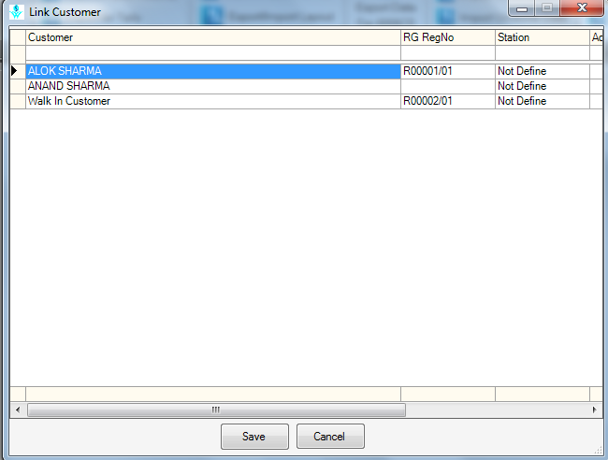
RG RegNo now editable in Link Customer/Vendor option of Export/Import Data

Slide 3
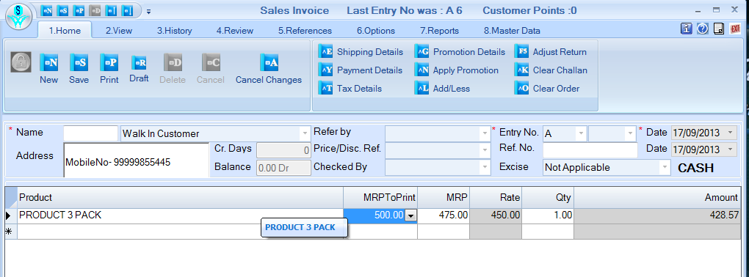
When 'Use Lot wise Rate' option is not selected in System Defaults then Rate and MRP to print both pick from Product and MRP is coming from Lot master.

Slide 4
Problem rectified in this version are ………..
Mail/SMS schedule showing error when Email address contains ';' or '&'.
'Allow product selection in Sales Return' rights now working.
Customer/Vendor selection now working properly in Import Transaction option.
RG RegNo now editable in Link Customer/Vendor option of Export/Import Data.
When 'Use Lot wise Rate' option is not selected in System Defaults then Rate and MRP to Print both coming from Product and MRP is coming from Lot master
When Default Location change to other location in location grid of Product Master, it is showing message 'Not a Valid UniqueID‘ on generation Unique ID.
Receivables/Payables not showing proper data when JV is adjusted in Receipt/Payment.
Showing run time error when click on Stock Detail option in Analysis.

