Slide 1
Retail Graph 2.5.06.01
Version Release on 12/09/2013

Slide 2
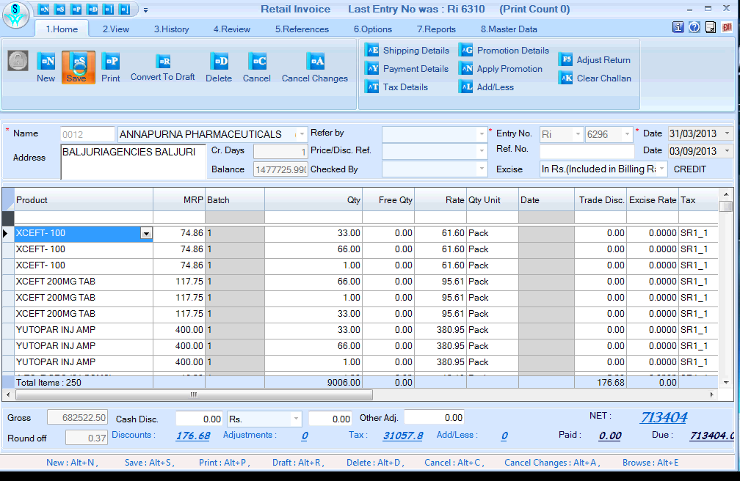
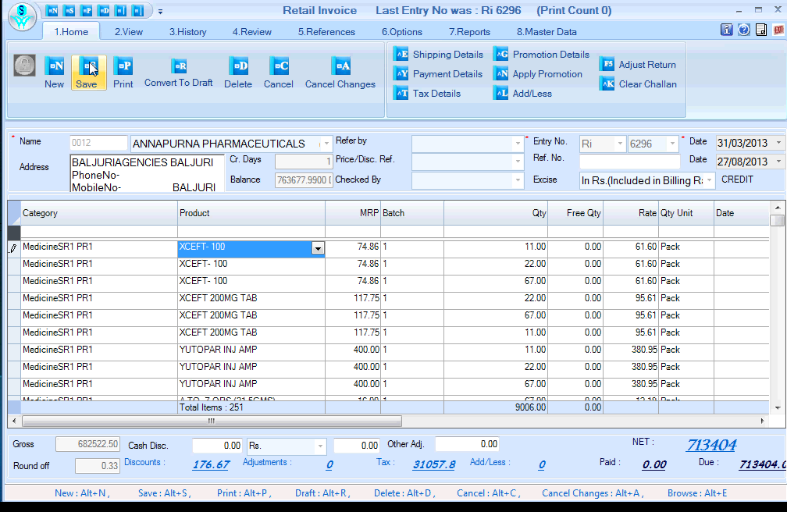
latest version 2.5.06.01
Old Version 2.5.06.00
Both movies are of Retail Graph, Invoice has 251 line items, Please click on both slides to compare difference in speed

Slide 3
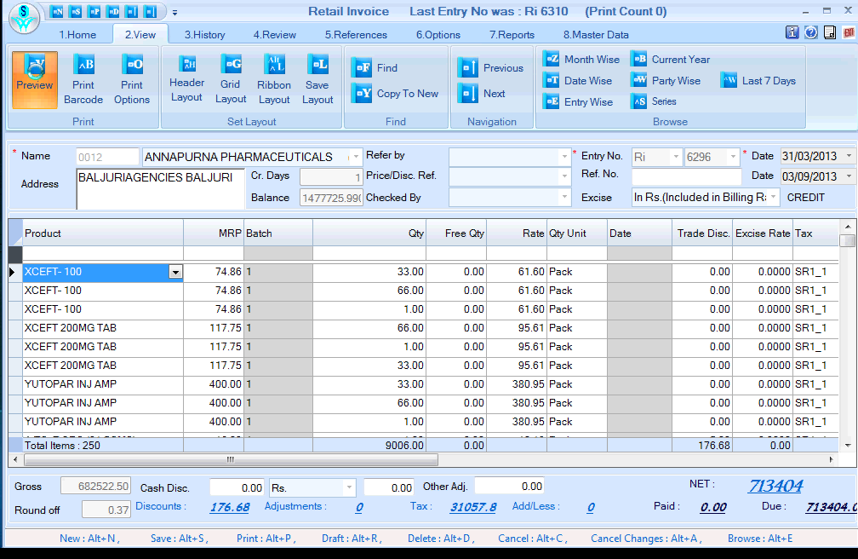
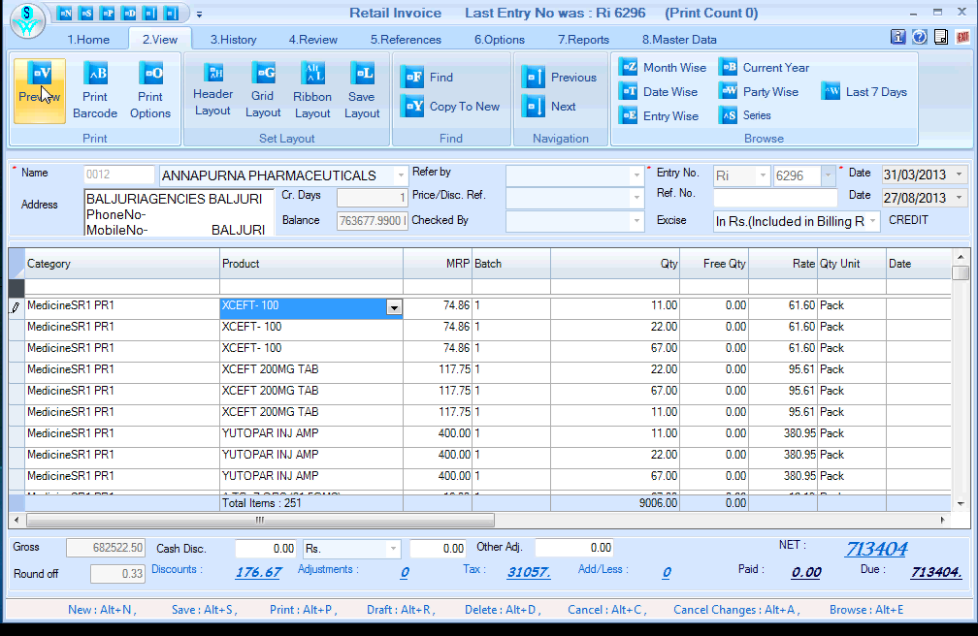
latest version 2.5.06.01
Old Version 2.5.06.00
Print Preview of same Invoice Please click on both slides to compare difference in speed

Slide 4
Problem rectified in this version are ………..
Issue regarding speed in transaction (sales and purchase) has been improved significantly as shown previous two slides.
Import is working on User Defined Form.
Sales Return print but not save issue is now resolved.

