Slide 1
Retail Graph 2.5.06.00
Version Release on 31/08/2013

Slide 2
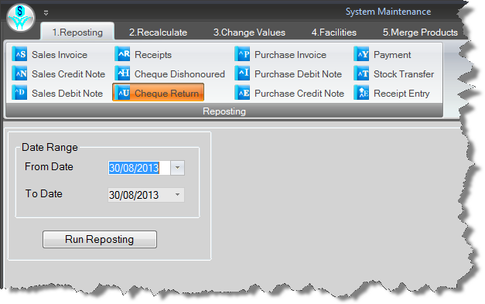
Now System Maintenance Reposting has Cheque Return Option

Slide 3
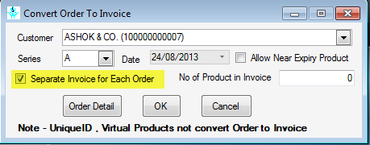
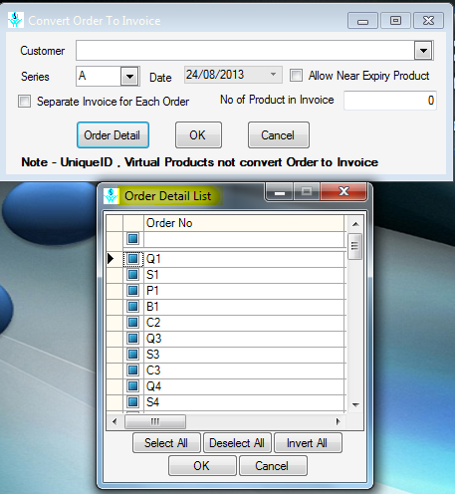
Option in Convert Order To Invoice to Create Separate Invoice for each Order & Order Selection for Multiple Customers

Slide 4
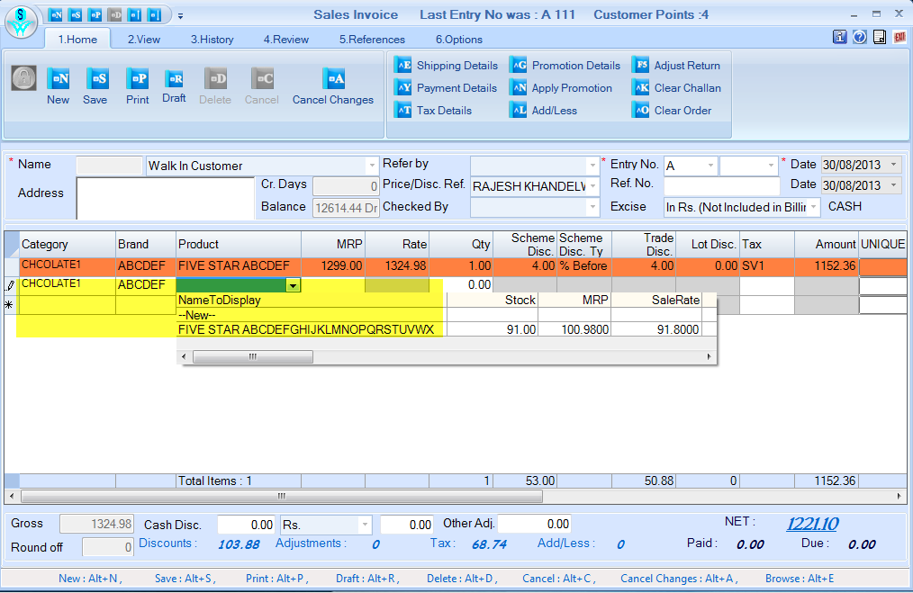
Category & Brand will be carry forward in next row when Product Category or Brand wise product List option is selected in System Default means previous row selected category or brand will show in next row, rest functionality remain same

Slide 5
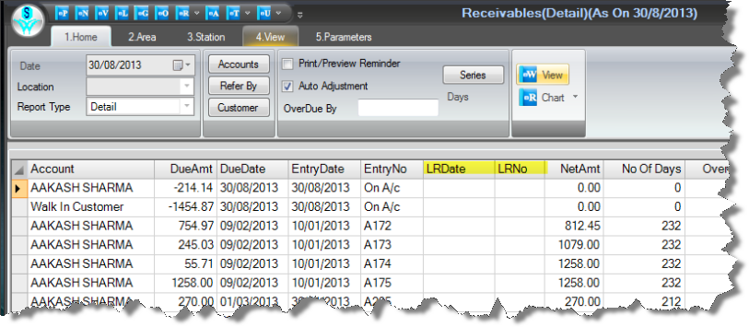
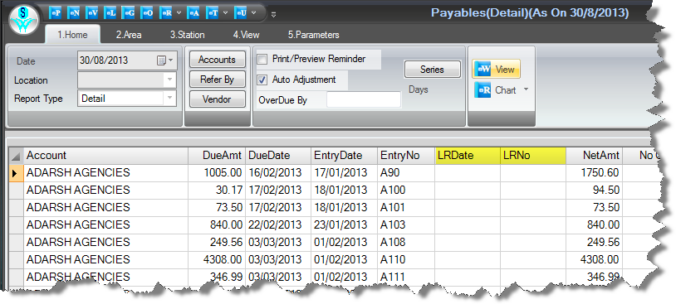
LR No & Date columns in Receivables/Payables

Slide 6
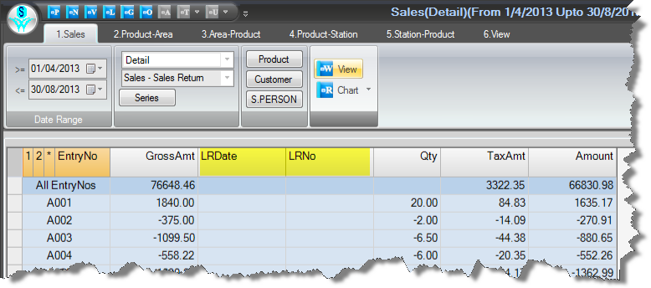
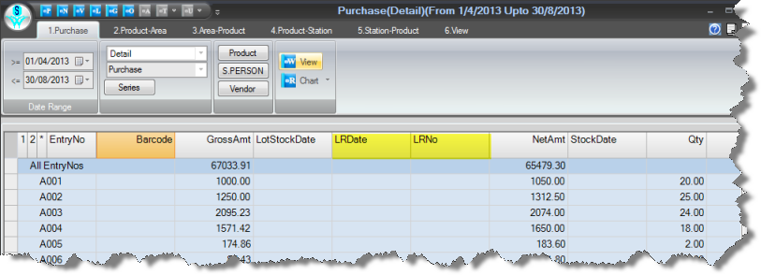
LR No & Date columns in Product wise Sales/Purchase

Slide 7
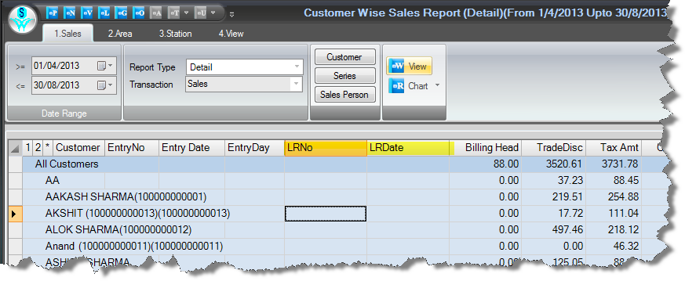
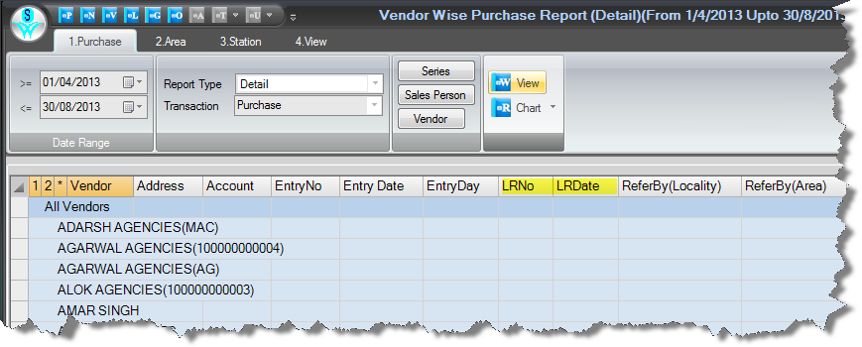
LR No & Date columns in Sales/Purchase Transaction Report.

Slide 8
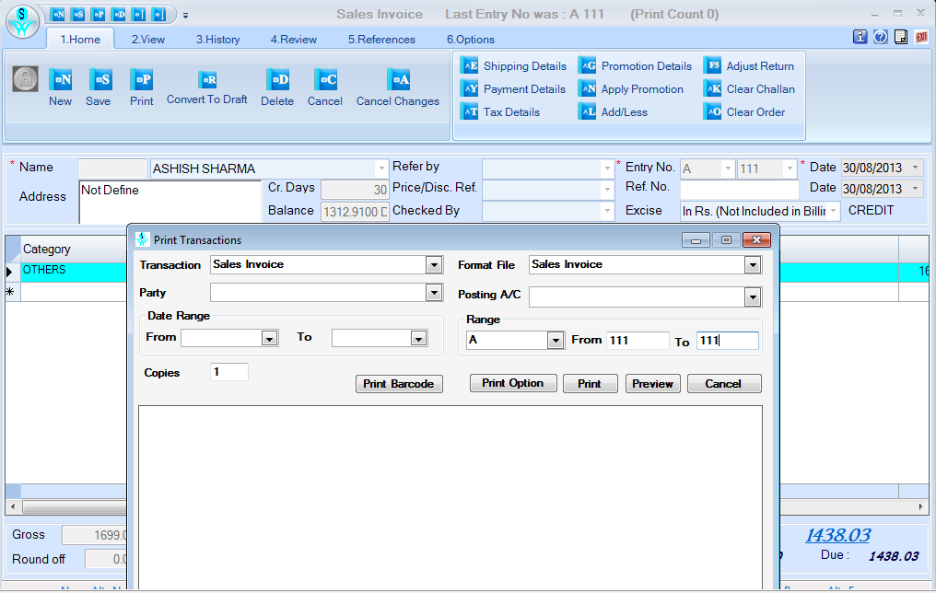
Now when Ctrl+F5 (Print Transaction) is used from Transactions it will save current transaction and open Print Transaction Option with Current Entry No.

Slide 9
Problem rectified in this version are ………..
On changing LR Date in shipping Detail, it is now calculating Due Date
On select non saleable return types, now it is picking Tax Type for Location.
Now error is handled when open Cheque Book
Now considering Stock Date when transfer stock through Location Transfer
Run time error is handled which coming in Transaction Status Reports
Create Default Format is handled for Reports in Export/Import Format.
In Issue Location Transfer form now showing location in edit mode

