Slide 1
RetailGraph
Updates after September 2014

Slide 2
Retail Graph 3.0.00.12
Version Release on 08/10/2014

Slide 3
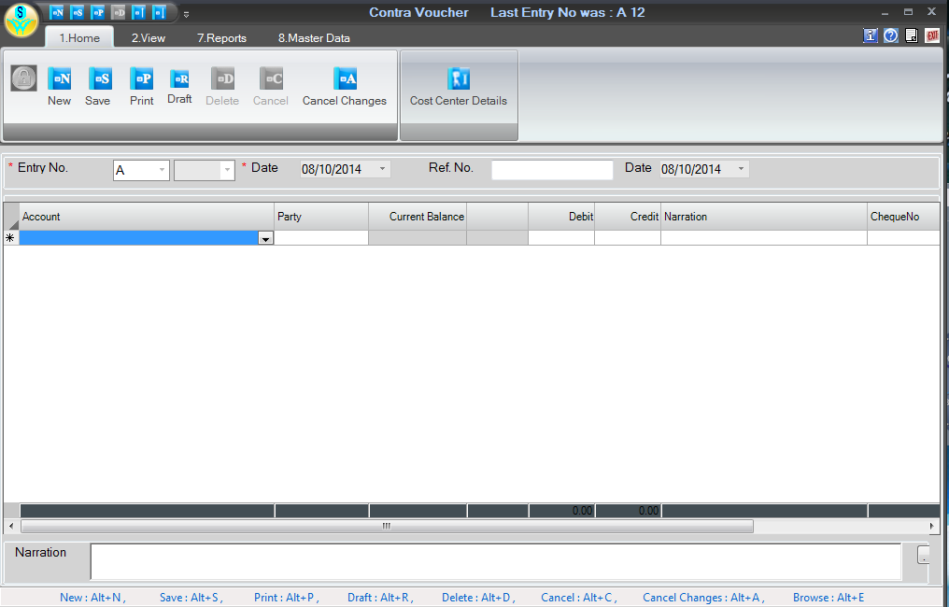
Contra Voucher Option.

Slide 4
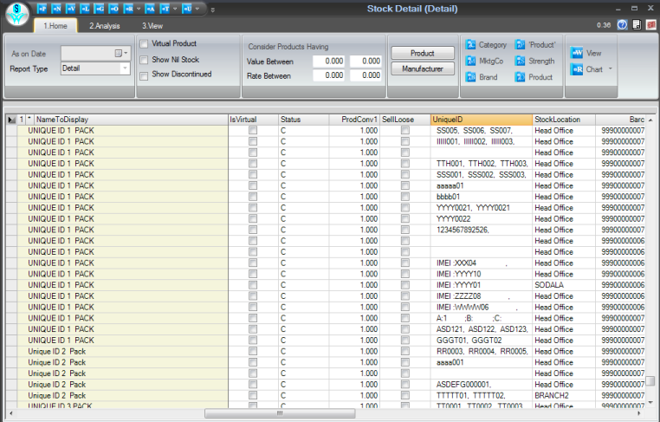
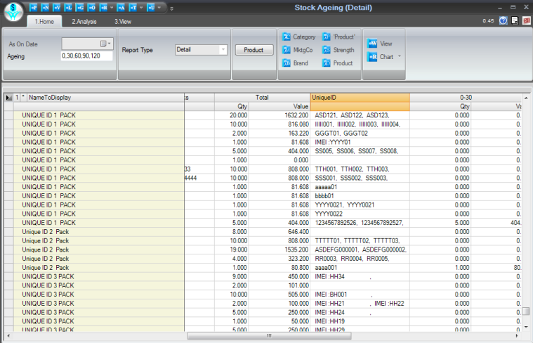
Unique ID Column in Stock Detail & Stock Ageing Report

Slide 5
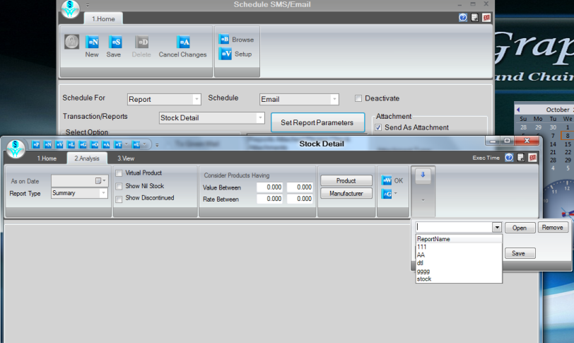
Schedule Option for Analysis Report, this will work only with reports having Analysis Tab

Slide 6
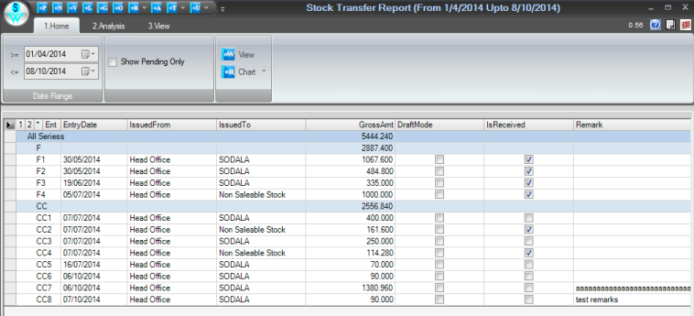
Remarks Column in Issue Location Transfer in Browser (Alt+E ) and in Stock Transfer Report

Slide 7
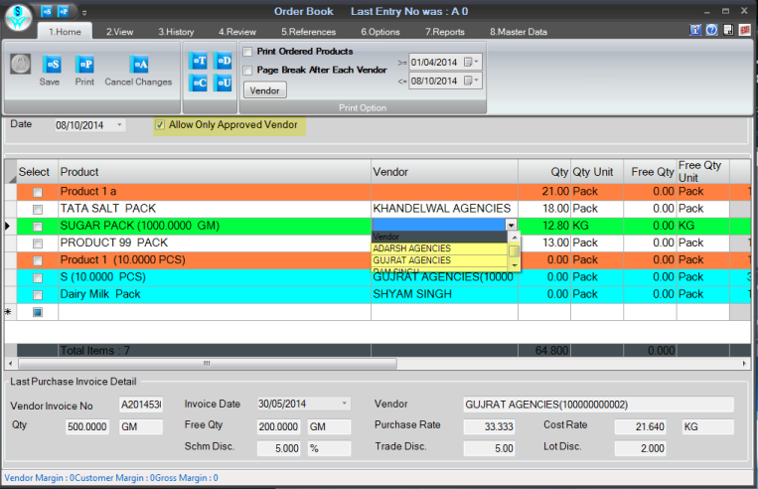
Option to Allow Only Approved Vendor in Order Book

Slide 8
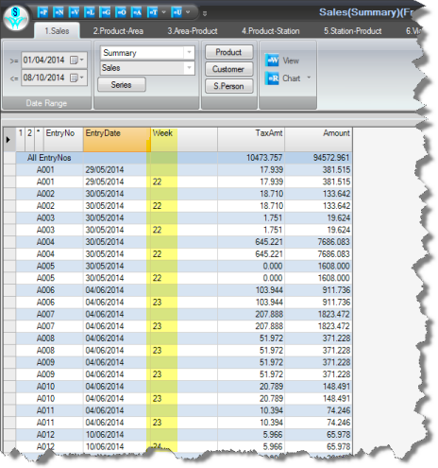
Week column in Reports as shown below in Sales Transaction Report

Slide 9
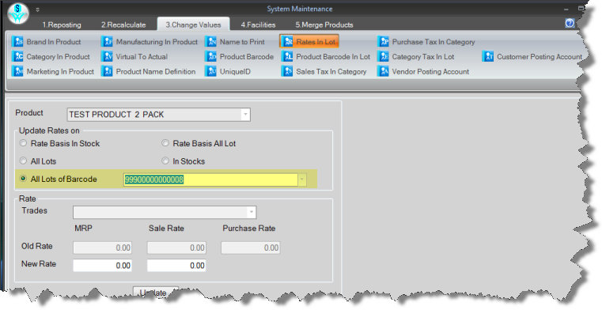
To change Rate of all Lots of particular Barcode

Slide 10
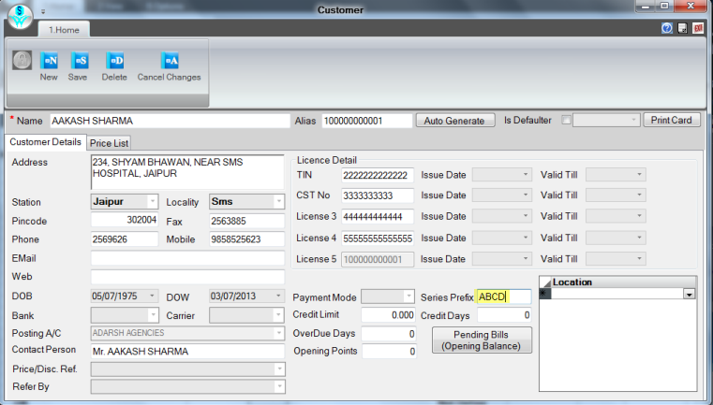
Wants to consider Multi Character in Series Prefix for Customer

Slide 11
Retail Graph 3.0.00.19
Version Release on 30/10/2014

Slide 12
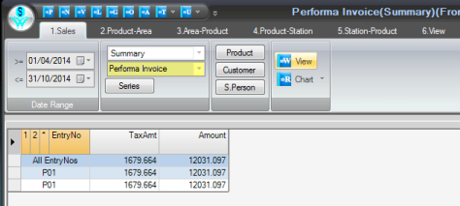
Performa Invoice option in Product wise Sales And Sales Transaction Report

Slide 13
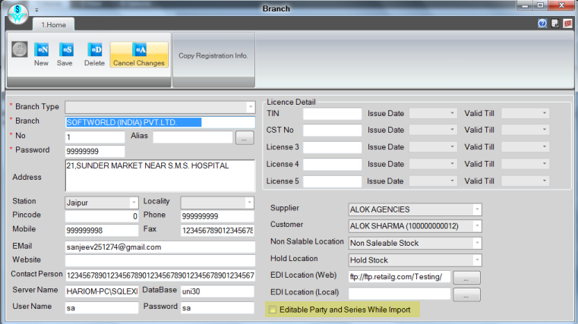
Option to lock Vendor Name and Series at Branch While Import Transaction

Slide 14
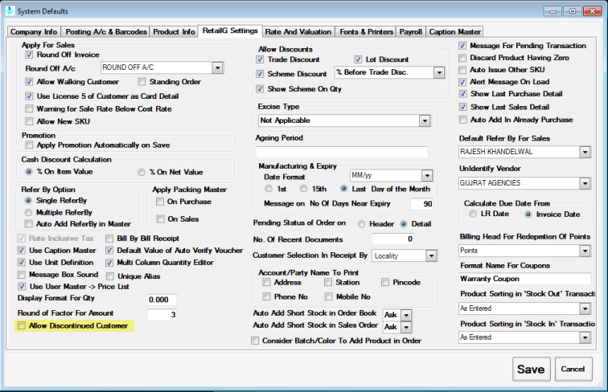
Not wants discontinue customer in Sales Return Now we have option in System Default > RetailGSetting > checkbox for "Allow discontinue customer"

Slide 15
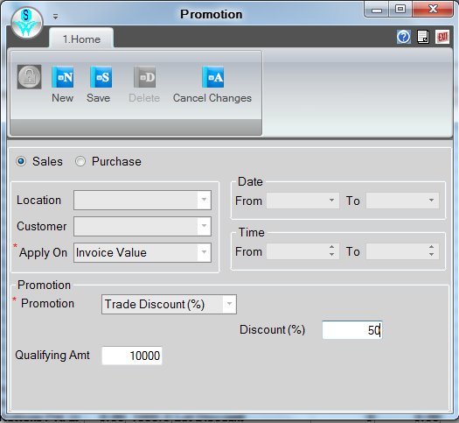
Wants to enter discount slab with using invoice value option in Promotion Master, Now for multiple slab then need to create multiple promotion, System will pick appropriate promotion

Slide 16
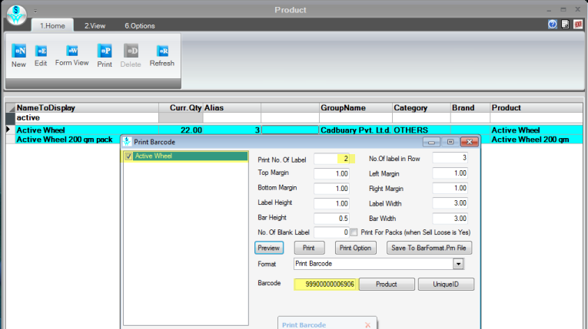
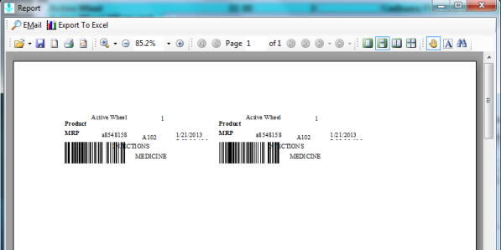
Now user can print Barcode (no. of Labels) according to the requirement.

Slide 17
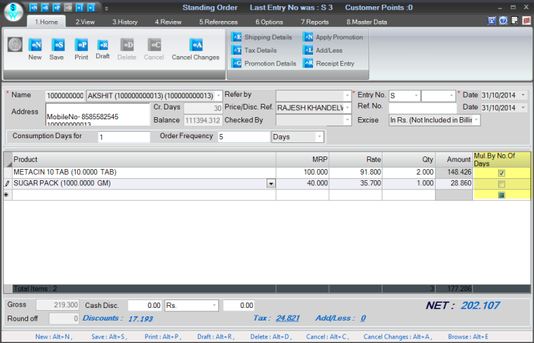
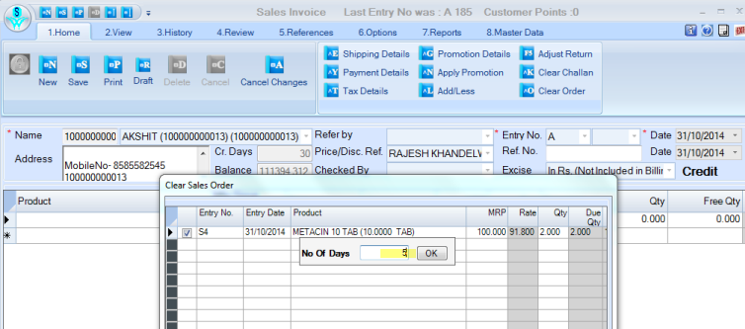
In standing order we have introduce one column i.e. "Mul. By No. of Days", its a check box which allows whether to multiple no. of days with qty or not. On Sales Invoice it is prompt for number of days

Slide 18
Problems rectified in different versions are ………..
01.Contra Voucher Option.
02.UniqueID Column in Stock Detail & Stock Ageing Report
03.Solved Problem VAT Forms not showing Proper Data in case of data exist for walking customer.
04.Schedule Option for Analysis Reports
05.Wants Remarks Column in Issue Location Transfer (Browser and Report both)
06.Wants Entry No., Entry Date & Remarks column not coming in report Stock Transfer Report
07.Not wants to Check Unique Ref No in Sales
08.Wants Approve Vendor option in Order Book

Slide 19
Problems rectified in different versions are ………..
09.Weekly Data column in Reports
10. To change Rate of all Lots of particular Barcode
11.Wants to consider Multi Character in Series Prefix for Customer
12.Wants Default value of previous Row in Detail Dynamic Form of Transaction
13.In case Scan Barcode or Unique ID in transaction then wants option to stay cursor on Dynamic Form in case there is dynamic form in Detail Grid.
14.Solved Problem Scan option on Unique ID editor not Working Proper(selection box not clear after scan and cursor going on grid after scan)
15.Sound On Messages.
16.Solved Problem in Product Category wise purchase

Slide 20
Problems rectified in different versions are ………..
17.Solved Problem Up arrow not working proper on Analysis Reports.
18.Solved Problem Vat Forms Showing double data when CrNote is adjusted in more than one Receipt.
19.Solved Problem Alias not showing in Party list in Vouchers.
20.Solved Problem Receipt Entry option in Sales Order is not working for Walkin customer(when change name).
21.Solved Problem Product wise Sales/Purchase Report not showing proper data in Monthly,Quarterly and Cumulative options.
22.Solved Problem New Lot Not generate in Reconcile Current Stock Option.
23.Solved Problem Receipt/Payment not calculate proper balance amount in case rebate is given in detail.

Slide 21
Problems rectified in different versions are ………..
24.Solved Problem Recalculate Due Qty also Consider Draft Transactions.
25.Solved Problem Showing error in Unique ID Query and in case continues then report show.
26.Solved Problem :: Not wants to provide rights of F11 in case deselect same from Ribbon in Transaction
27.Solved Problem :: Software Hang Sometimes after select product in Sales Invoice.
28.Solved Problem :: Showing Error in Reconcile(Draft Mode)
29.Solved Problem :: Registration Export/Import not working
30.Solved Problem :: Rate not pick from Lot in Transaction.
31.Solved Problem :: Assembly name field not update in Form_Mas not update due to this issue not open dynamic form

Slide 22
Problems rectified in different versions are ………..
32.Solved Problem :: in Print Option in Print Transaction and also not working in case change format and Preview same
33.Solved Problem :: Refer by Commission
34.Solved Problem :: Last Purchase Screen not showing proper
35. Performa Invoice option in Product wise Sales And Sales Transaction Report.
36. Option to lock Vendor Name and Series at Branch While Import Transaction
37. Not wants discontinue customer in Sales Return(System Default > RetailGSetting > checkbox for "Allow discontinue customer")
38. Wants to enter discount slab with using invoice value
39. Now user can print Barcode (no. of Labels) according to the requirement.

Slide 23
Problems rectified in different versions are ………..
40. Solved Problem :: In standing order we have introduce one column i.e. "Mul.By No. of Days", its a check box which allows whether to multiple no. of days with qty or not. So in Sales invoice it will ask for number of days, So it will apply on entire order.
41. Solved Speed Issue of Recalculate Customer/Vendor Balance
42. Solved Problem :: Product Sequence change when use Convert Order to Invoice option.
43. Solved Problem :: Single UniqueID Option is not working in F5.
44. Solved Problem :: In Sales Invoice allow Multiple times same Unique ID product select and save
45. Solved Speed Issue of Sales/Purchase Challan Due Qty Integrity Option.
46. Solved Problem :: Extra SP of Masters was not working in Import/Export
47. Cost Rate not updating in Adjustment in case create new lot.

Slide 24
Problems rectified in different versions are ………..
48. Not wants Customer ledger of Discontinue Customer and also not wants same in list of customer in same report
49. Not wants tagging window in case export and import in same database
50. Do not convert Purchase Challan/Sales Challan in Previous Date
51. Ledger Display shows alias in Account Combo
52. Vendor Ledger and Customer Ledger both shows alias in Posting Account
53. Marketing Group Wise Out Standing shows alias in Marketing Group combo
54. In Reconcile last Shortage Surplus details was shown every time same and does not change according to product selection

Slide 25
Problems rectified in different versions are ………..
56. Showing error in all transaction of purchase and sales credit note in case of Unique Id.
57. Solved Problem :: In Dynamic Form Query not working n case of Delete Record from Grid Table
58. Solved Problem :: Manufacturer not update in lot in case import branch transfer
59. Solved Problem :: Problem in vendor wise sale and stock statement in case of branch import export(manufacturer wise)
60. Solved Problem :: Automatic Version Not Load Through CRM
61. Solved Problem :: Wants to ask No. Of Days only Once when clear Standing Order in Sales Invoice
62. Solved Problem :: In case click on Step 1 Query then showing error in case define Step 2 in Query.

Slide 26
Problems rectified in different versions are ………..
63. Solved Problem :: Showing error in case Select Challan of Previous Date and Save Invoice
64. Solved Problem :: In Transaction:: Showing error in case Batch List is Blank
65. Solved Problem :: Not working Account Filter of Daybook
66. Solved Problem :: Export not working in case records greater then 65000
67. Solved Problem :: In case Select Product and Scan Barcode then Remark on next row not copy
68. Solved Problem :: Wants to show negative value in case Sales Credit Note in DayBook.
69. Solved Problem :: Showing Error in Export/Import.
70. Solved Problem :: Software Hang in case use Dynamic form in F5 Return Entry.

Slide 27
Problems rectified in different versions are ………..
71. Solved Problem :: Export Report In Excel
72. Solved Problem :: Return Type Price Difference not working in Transaction.
73. Solved Problem :: Clear Return remove from Adjust Return of Challan, F5 is there to enter return manually.
74. Solved Problem :: Master -> User -> Restricted Series Prefix option is not working accordingly likewise if we want to restrict series with prefix "AB", it will also restrict series "A".
75. Solved Problem :: Sales Replacement and Purchase Replacement -> Adjust a return against invoice and use that return in the replacement. On edit mode when fired save it will generate casting error.
76. Solved Problem :: Giving error in Dishonored Cheques -> With Return to party option press Save button.

Slide 28
Problems rectified in different versions are ………..
77. Solved Problem :: Purchase Invoice unique id product 4 qty and now sale 2 qty, now purchase return of that purchase invoice it will misbehave, if we just select all unique id and save.
78. Solved Problem :: Inventory -> Receive indent(Location Transfer) :- When focus is not at grid and Edit button is pressed then it will generate error.
79. Solved Problem :: If we convert a challan(in which standing order is cleared) to invoice was not working
80. Solved Problem :: If transfer stock partially used and then through System Maintenance > Facilities > Cancel Received Goods >> choose that transaction >> shows error
81. Solved Problem :: Price Difference of multi qty product in return adjust same in invoice not working properly

Slide 29
Problems rectified in different versions are ………..
82. Solved Problem :: Case Lot error in import product master
83. Solved Problem :: Vendor Filter not work in vendor wise near expiry
84. Solved Problem :: Delete not allow in case dynamic form select in ribbon layout.
85. Solved Problem :: Tax going blank in prodlot_dtl in case product conversion
86. Solved Problem :: Product Query not showing proper data in case select particular Location and make Issue Location Transfer
87. Solved Problem :: System Maintenance > Facilities > Delete Unused Lots Not working proper. It removes lot from tblprodstock_dtl not from tblprodlot_dtl
88. Solved Problem :: Auto Purchase Order not clear and also clear as per FIFO method

Slide 30
Problems rectified in different versions are ………..
89. Solved Problem :: Sales and Stock Statement Billing Valuation not wants to consider Free Qty.
90. Solved Problem :: Product Detail Report >> when Report Group on 'Lot', then in detail section it is showing column Batch and Color if they applied on product.
91. Solved Problem :: Issue Location Transfer >> Collect Expiry Data >> fetch expiry data according to location series and transfer on selected Location .
92. Solved Problem :: DashBoard on Background Thread.
93. Solved Problem :: In Purchase invoice, Unique id Generates automatically according to next maximum number with prefix UID.
94. Solved Problem :: Wants to Print Barcode wise Unique ID.
95. solved Problem :: Restore Grid Layout not working on Unique ID (Purchase Invoice)

Slide 31
Problems rectified in different versions are ………..
96. Solved Problem :: Print Barcode >> Unique ID product barcode printing was not correct.
97. Solved Problem :: Stock Detail >> Report different when Select As On Date and keeping date blank.
98. Solved Problem :: New Database Update >> Error rectified in case new data creation.
99. Solved Problem :: If product scan in F5, it was generating new lot(SKU definition is lot).
100. Solved Problem :: If in table tblSalesInv_dtl has NULL in unique id column that particular invoice if we edit and convert to draft then it is giving error.
101. Solved Problem :: Now Lot Remarks are coming in all transaction.

Slide 32
Problems rectified in different versions are ………..
102. Solved Problem :: Wants to import remark of detail when import Sales\Branch Transfer In.
103. Solved Problem :: Sales Order clear in Sales Challan and sales Challan clear in Sales Invoice, it deduct twice from sales order and due qty becomes negative.
104. Solved Problem :: Sales Order status report misbehaving(summary and detail) incase order cancel through order verification.
105. Solved Problem :: ReOrder Report not working properly with vendor selection.
106. Solved Problem :: Purchase Invoice, on change expiry date it is giving Casting Error
107. Solved Problem :: Daily Sales and Purchase Report giving error while series wise checkbox not checked.

Slide 33
Problems rectified in different versions are ………..
108. Solved Problem :: Company Name and Current Year is not showing properly in Header.
109. Solved Problem :: Lot Remarks not coming in Sales Return and Sales Credit Note in case Select Sales Invoice.
110. Solved Problem :: Dynamic Form Issue :: Select Record from Grid for edit on form, Click on new option for new entry on form it will clear data for new entry but if you click on refresh option again, it will pick previous entry which we edit.
111. Solved Problem :: Employee Code Not Working in Checked By Field
112. Solved Problem :: Report Purchase Return Status and Sales Return Status, if report type is Detail then it won't show Adjusted data those are adjusted through Invoice.
113. Solved Problem :: Stock Date not update proper in case Receive Issue Location Transfer and then edit date.

Slide 34
Problems rectified in different versions are ………..
114. Solved Problem :: Refer By duplicates, when refer by Select in Price Disc/Ref same refer by entered while selecting drop down and it does not match with existing refer by So(auto create) the same.
115. Solved Problem :: Error is coming on save Product Master in case of using Dynamic Form on Product Master.
116. Solved Problem :: In Sales Invoice on Customer Selection it is showing error if Customer information "Address+Station+PinCode+Email+Fax+Phone" length exceed 400 characters.
117. Solved Problem :: In Dynamic Form printing format [_Getdata] Variables not working, In case of we have get query and update query on dynamic form.
118. Solved Problem :: Problem is that value of @ID is not going refresh in case of edit record and then use of new options.
119. Solved Problem :: Schedule issue auto run again after 15 min.

Slide 35
Problems rectified in different versions are ………..
120. Solved Problem :: Showing Pending Challan after clear in some cases.
121. Solved Problem :: Problem in reconcile in case IMEI No. have CHAR(10) and CHAR(13)
122. Solved Problem :: Sales Credit Note Save without Payment Mode.
123.Solved Problem :: Adjustment Column Vanished from Journal Voucher.
124. Solved Problem :: Wants Barcode Default in barcode field in case scan product in Branch TransferIn
125. Solved Problem :: In Purchase Invoice "Empty Batch" message coming while select product and move to next row of grid.
126. Solved Problem :: In case Cancel Transaction, Its Date Modified not updated and also no record in Log Table.

Slide 36
Problems rectified in different versions are ………..
127. Solved Problem :: When show calendar on desktop, it creates folder and then not allow to remove Calendar.
128. Solved Problem :: Wants Party account name in Payments >> PDC To Cleared.
129. Solved Problem :: ConnectFormID in tblDynamicForm_Dtl not coming proper in case Export Dynamic form and import same in other database on same version.
130. Solved Problem :: Initial Query not working on form in case we have parameter form with dynamic form and form type is "T".
131. Solved Problem :: Wants to send single message in case select all from contact(Customer and Account both having Mobile No.)
132. Solved Problem :: Customer Address with consolidate Size approx 500, working fine

Slide 37
Problems rectified in different versions are ………..
133. Solved Problem :: Discontinue Customer is now coming in Receipts
134. Solved Problem :: Restaurant(Touch Screen UI), now showing rate according to define in Billing Rate.
135. Solved Problem :: Now RetailGraph compatible with Local DB, SQL2012 and SQL Azure.
136. Solved Problem :: Purchase Return >> Fetching stock from Non Saleable Stock, showing correct Expiry Date.
137. Solved Problem :: Daily Sales Report and Daily Purchase Report, we disable Set Grid Layout since it is not required on this report and it is creating disturbing report.
138. Solved Problem :: Showing another version already install
139. Solved Problem :: Showing error in deploying Data

Slide 38
Problems rectified in different versions are ………..
140. Solved Problem :: Showing error in receipt entry in case use of Bank Account in Account Field.
141. Solved Problem :: Showing error in purchase invoice in case use Backspace to remove Vendor.
142. Solved Problem :: Showing error in Export/Import in case use Backspace to remove Vendor.
143. Solved Problem :: Showing Last Invoice no. in log in case of cancel.
144. Solved Problem :: Export/Import >> Import CSV file giving Casting error
145. Solved Problem :: Export/Import Purchase >> Import CSV showing Error when Purchase Discount is given in discount master
146. Solved Problem :: Export/Import Purchase >> Import CSV Import only Single Product when Product List is Optimized on Alias in System Defaults

Slide 39
Problems rectified in different versions are ………..
147. Solved Problem :: Stock Location not assign Proper in Purchase Return while select Expired/Damaged Return Type.4. Solved Problem :: Showing error in purchase invoice in case use Backspace to remove Vendor.

